Slide 1
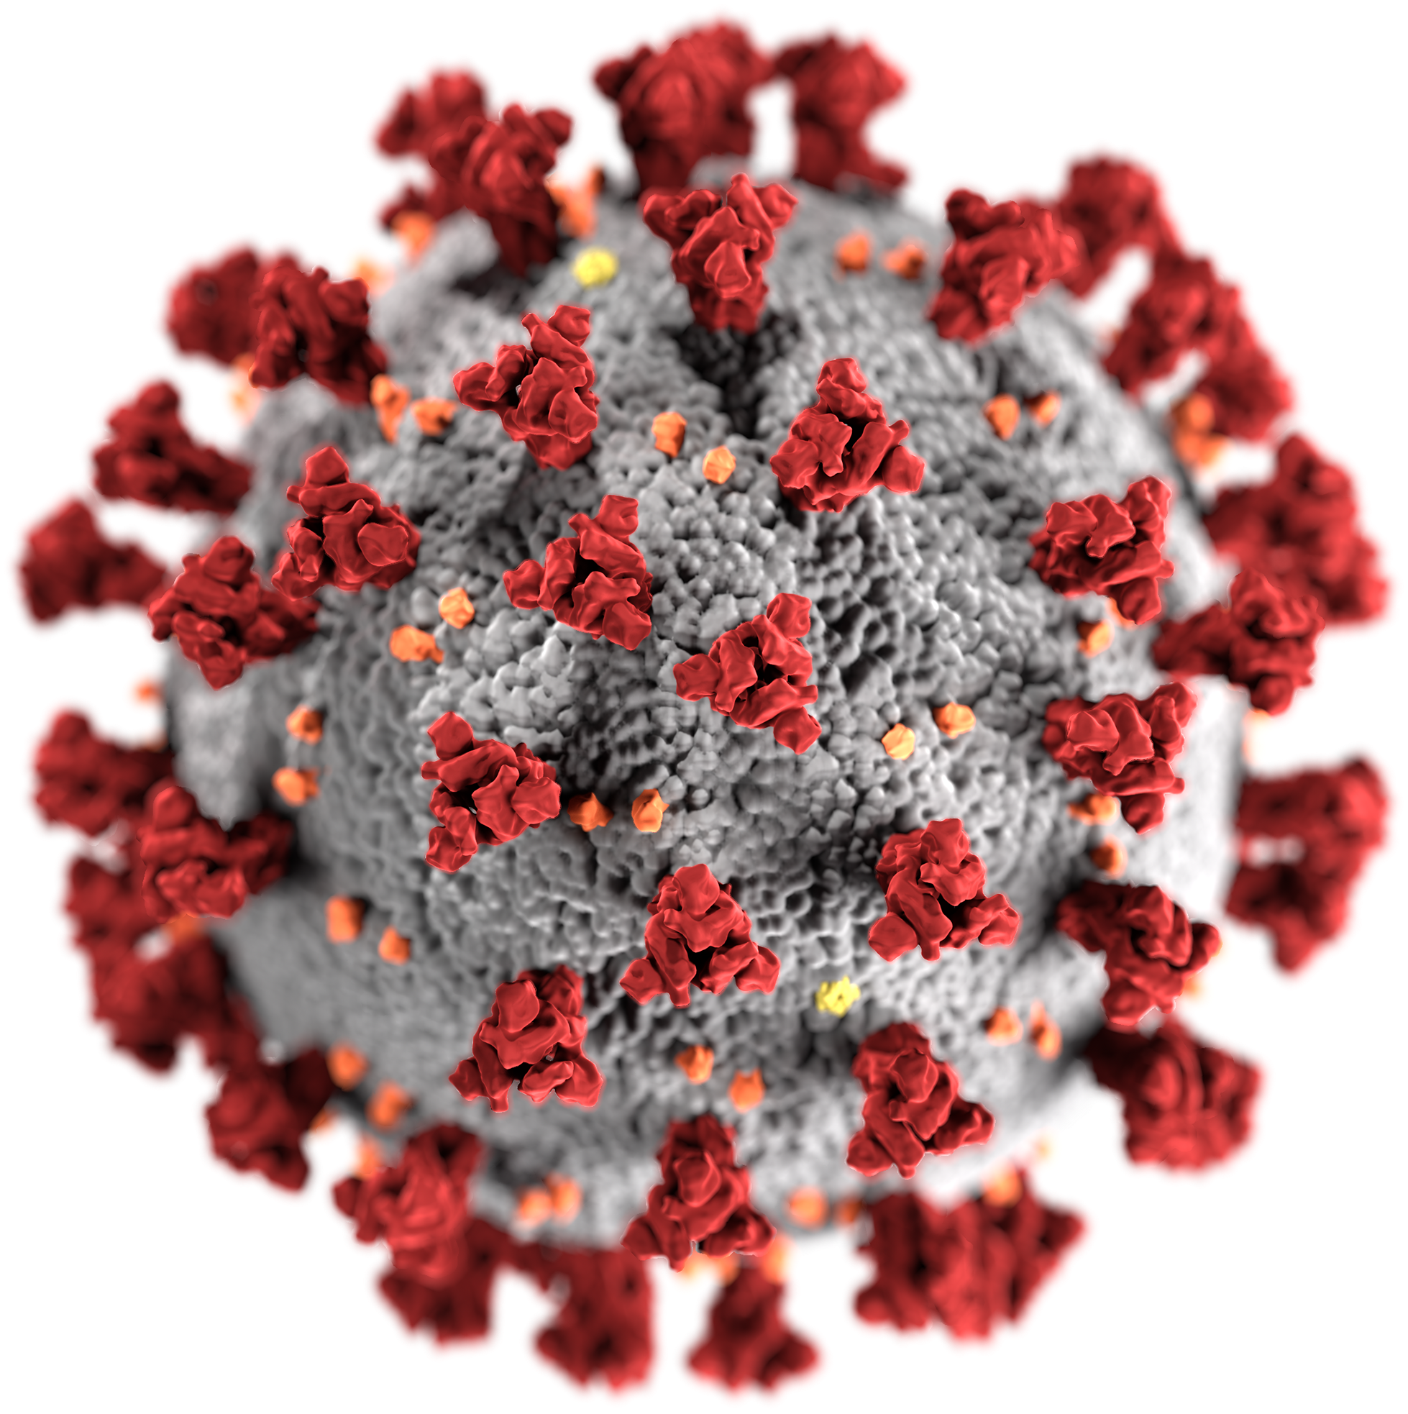
Global COVID-19 Crisis Analysis
.

Slide 2
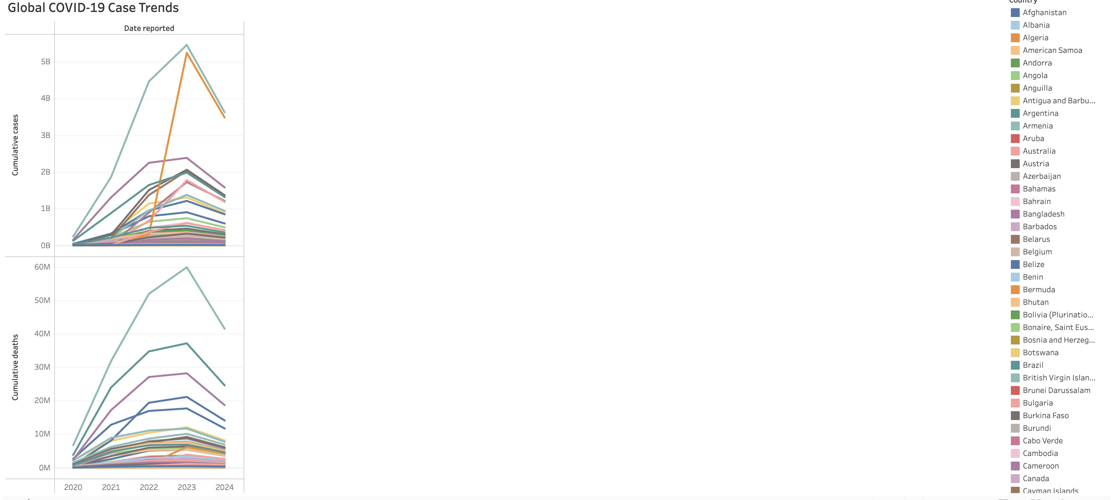
Data Organization: The dataset is organized by key metrics—Cumulative Cases, Cumulative Deaths, and Date Reported—segmented by Country. This structure facilitates tracking and comparing the pandemic’s global progression, providing a comprehensive view of country-level impacts and trends over time.
A dual-axis line chart is used to effectively visualize cumulative cases (left axis) and cumulative deaths (right axis). This allows us to see both metrics simultaneously, highlighting global and country-specific surges in the pandemic.
Key Insights:
Global Peaks: A significant peak in 2022, followed by a decline, indicates effective intervention strategies (vaccinations, restrictions).
Time-Lag Effect: The chart reveals a time lag between case surges and corresponding death spikes, showcasing the typical progression of the virus.
Country Comparison: Countries like Brazil and India show sharp increases, indicating strain on healthcare systems, while others managed to flatten the curve.

Slide 3
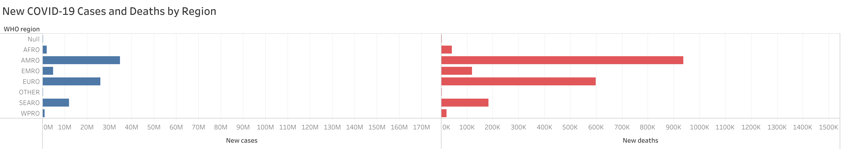
Data Organization: This bar chart separates the data by WHO Region to compare the impact of COVID-19 in terms of new cases and new deaths. The data structure facilitates region-level comparisons for clearer insights on the global pandemic response.
Key Insights:
Highest Impact: Regions like AMRO (Americas) and EURO (Europe) show the largest bars for both cases and deaths, indicating these areas were most affected by the virus.
WHO Regional Focus: Understanding how different regions managed the pandemic can guide future healthcare policies and resource distribution.

Slide 4
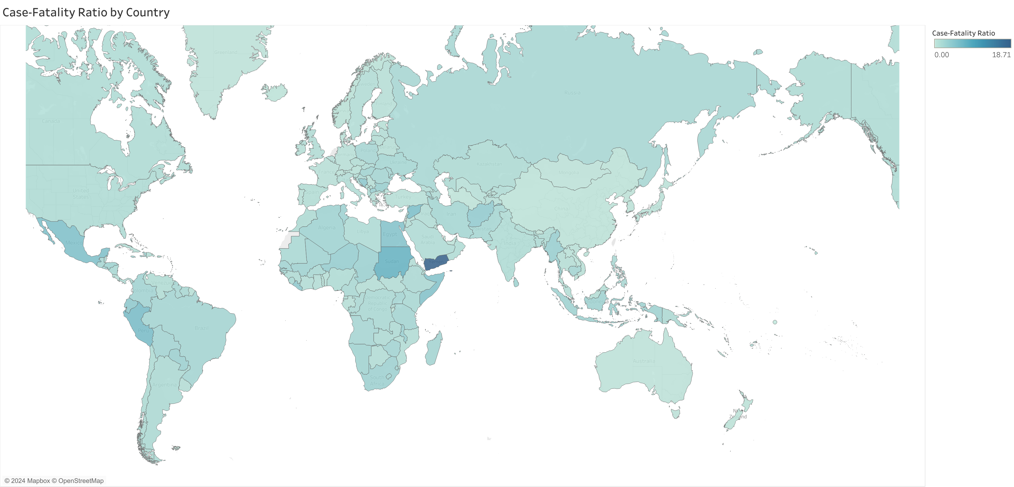
Data Organization: The data is organized by Country with each country shaded according to its Case-Fatality Ratio (CFR). Darker shades represent higher CFR, while lighter shades indicate lower death rates relative to case counts.
Key Insights:
Highest Fatalities: Countries in the Middle East, such as Yemen, show the darkest shades, indicating the highest case-fatality ratios. This suggests these countries faced challenges in healthcare capacity and crisis management.
Global Variation: Countries like Mexico and Peru show higher CFR, potentially due to overwhelmed healthcare systems or lack of timely interventions.
Healthcare Focus: This map helps identify countries where medical infrastructure may have been insufficient, highlighting areas for future investment in healthcare resilience.

Slide 5
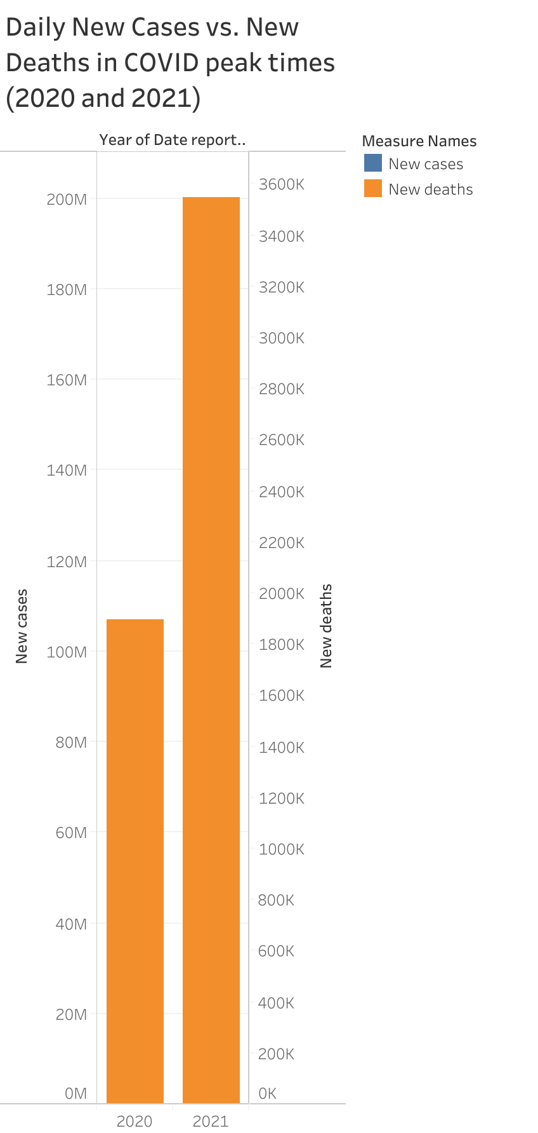
Data Organization: This vertical bar chart compares New Cases and New Deaths over two peak pandemic years (2020 and 2021). The dual metric allows easy comparison of how cases surged and deaths followed.
Key Insights:
Dramatic Increase in 2021: There’s a significant increase in new cases and deaths in 2021 compared to 2020, highlighting the impact of new virus variants and relaxed restrictions.
Higher Mortality in 2021: The larger death bar in 2021 compared to 2020 indicates more severe outcomes, possibly due to delayed vaccinations or healthcare system strain.
Crisis Management: This chart emphasizes the need for effective interventions in peak times to control both case numbers and subsequent deaths.

Slide 6
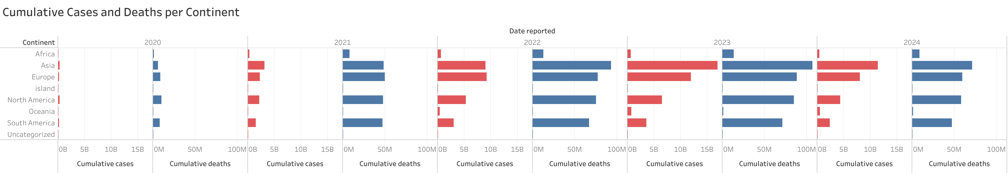
Data Organization: This chart breaks down Cumulative Cases and Cumulative Deaths by Continent for each year from 2020 to 2024. It shows how COVID-19 spread over time and the corresponding death tolls.
Key Insights:
Pandemic Waves: The chart shows distinct waves, with 2021 and 2022 as the most significant years for cases and deaths across continents like Europe and North America.
Asia’s Rising Impact: In later years (2022 onwards), Asia shows an increasing number of cases, emphasizing the continued spread of the virus in different waves.
Healthcare Disparity: The gap between cumulative cases and deaths varies greatly across continents, highlighting healthcare system differences and the efficacy of pandemic responses.

Slide 7
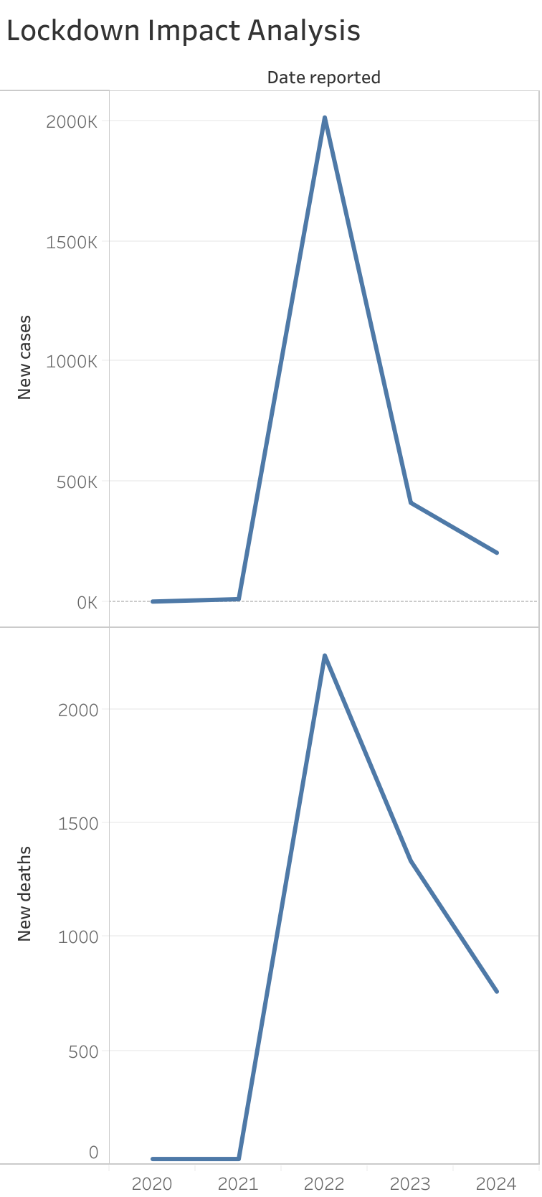
Data Organization: This dual-axis line chart tracks New Cases and New Deaths by Date to show the impact of lockdowns. Countries can be filtered to analyse the effect of restrictions.
Key Insights:
Sharp Decline Post-Lockdowns: There’s a clear decline in both cases and deaths after 2022, coinciding with widespread lockdowns and vaccinations.
Effectiveness of Measures: The chart shows that strict lockdown measures were highly effective in controlling the spread of the virus, as seen in the drastic reduction in new cases after 2022.
Pandemic Control: This chart underscores how timely interventions can flatten the curve and reduce death tolls in pandemic scenarios.

Slide 8
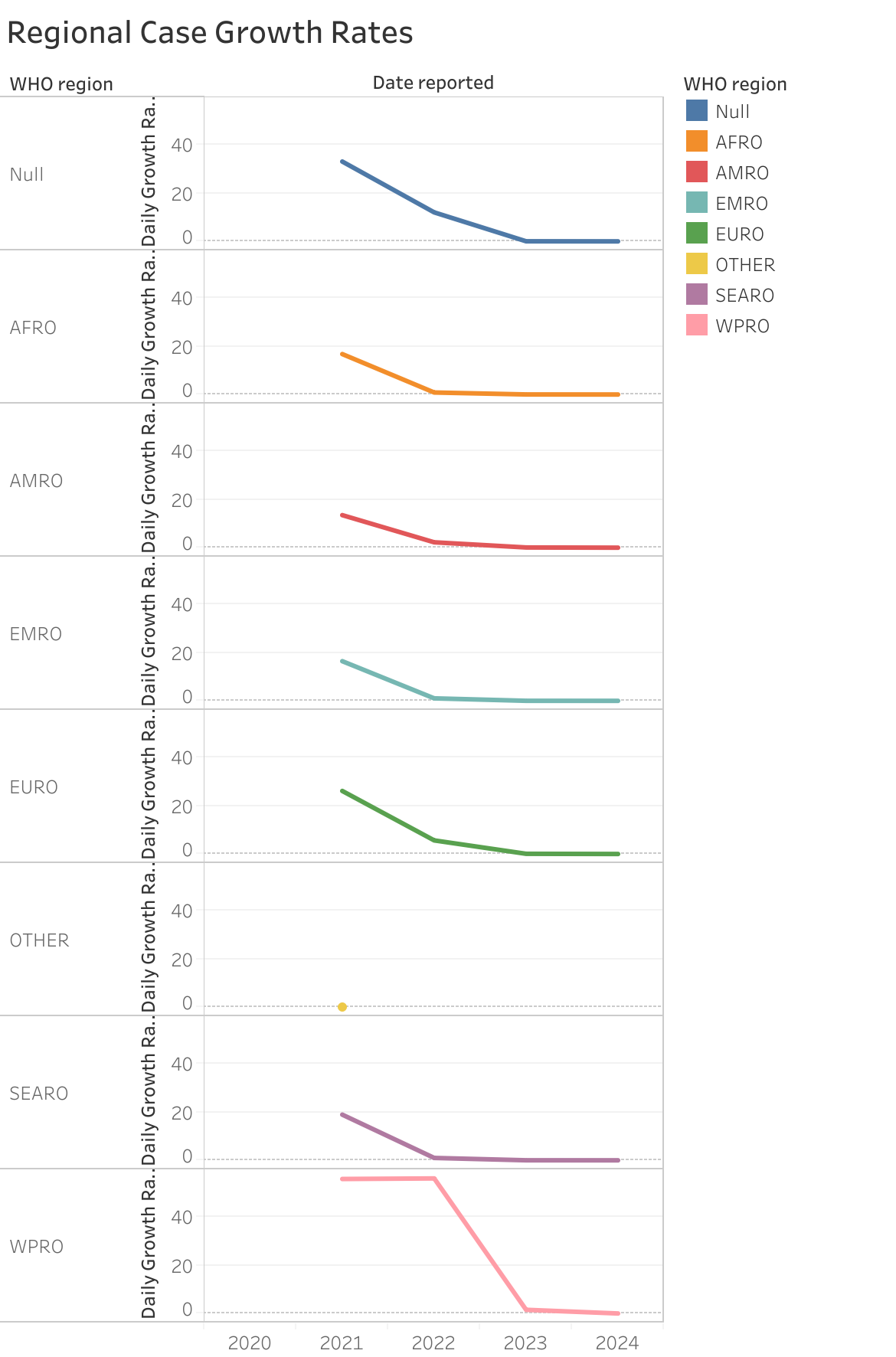
Data Organization: The chart tracks Daily Growth Rates for different WHO Regions, allowing us to compare how the pandemic's growth rate evolved across regions from 2020 to 2024.
Key Insights:
Decelerating Growth Globally: Most regions, including AMRO (Americas) and AFRO (Africa), show declining growth rates after 2021, indicating that the pandemic was gradually being controlled in these areas.
Effective Interventions: The steady decline across regions suggests successful public health measures, such as lockdowns, vaccination campaigns, and public compliance, played a major role in reducing the transmission rates.
Regional Differences: Although all regions show declines, the rate of decrease differs, highlighting that some regions, such as EURO (Europe), managed to stabilize the growth faster than others, while regions like SEARO (Southeast Asia) took longer to see the same reduction.

Slide 9
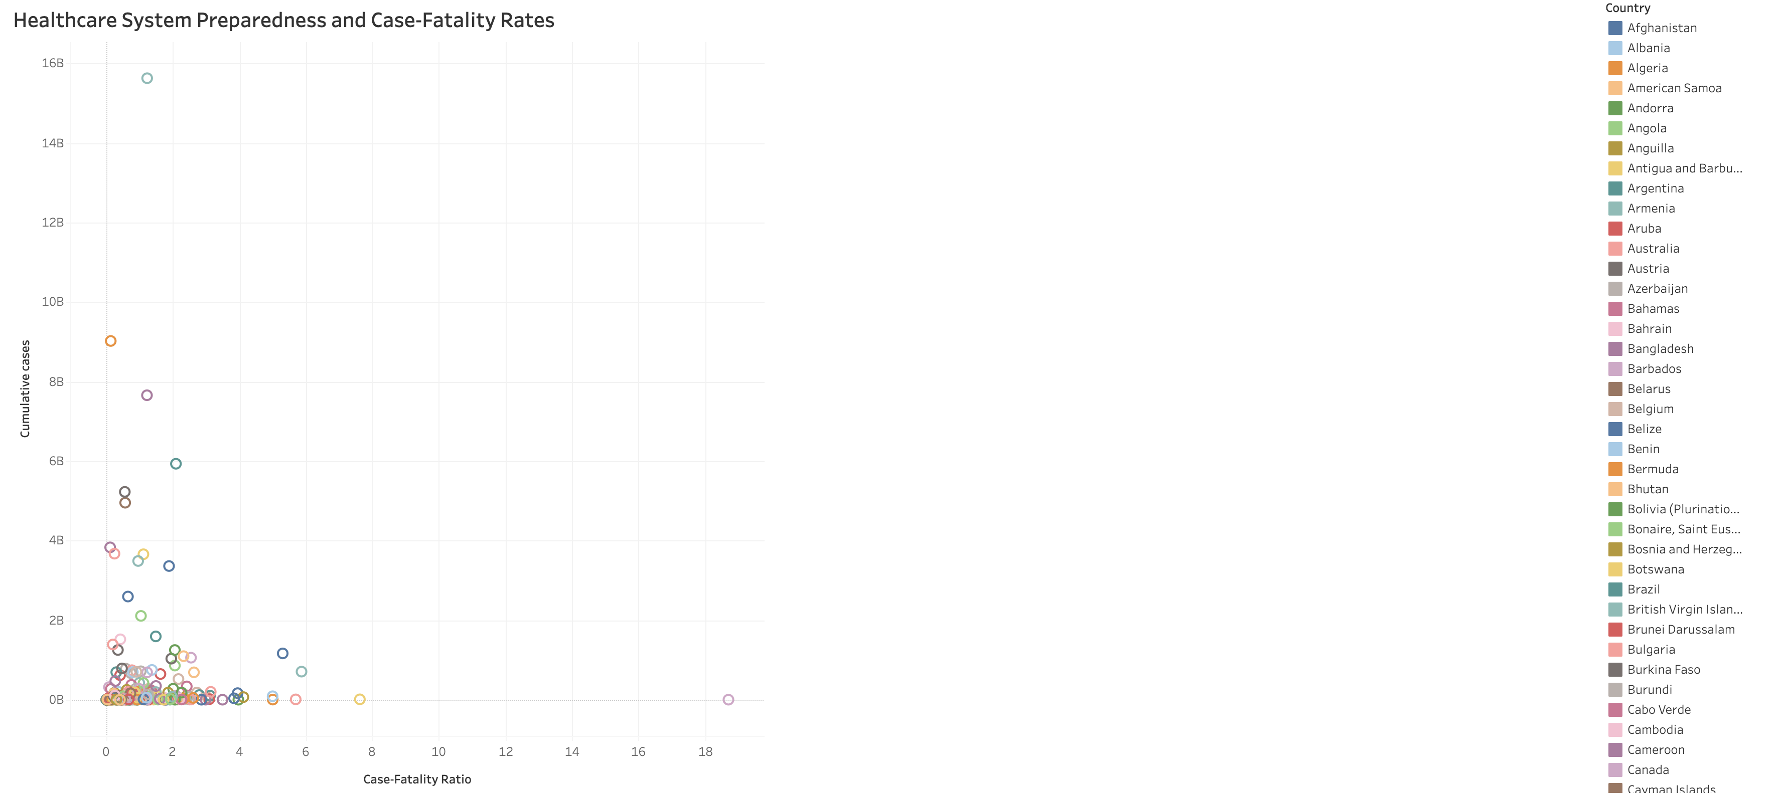
Data Organization: This scatter plot compares Cumulative Cases with the Case-Fatality Ratio (CFR) for each country, allowing us to examine how the severity of COVID-19 cases relates to healthcare capacity and outcomes across different countries.
Key Insights:
High CFR in High-Case Countries: Countries with both high case counts and high CFR (like Yemen) suggest overwhelmed healthcare systems, leading to higher mortality rates. These countries faced severe strain during the pandemic.
Well-Prepared Nations: Countries like Germany and South Korea, which have high cumulative cases but low CFR, reflect better healthcare infrastructure, resource availability, and effective pandemic management strategies.
Healthcare Challenges: Countries with a high CFR but low case count may indicate issues such as delayed response, underreporting, or inadequate healthcare systems to handle even smaller outbreaks.
Resource Allocation Insight: This chart is critical for pinpointing where healthcare systems were overwhelmed and highlights the need for improved healthcare capacity and rapid response for future pandemics.

Slide 10
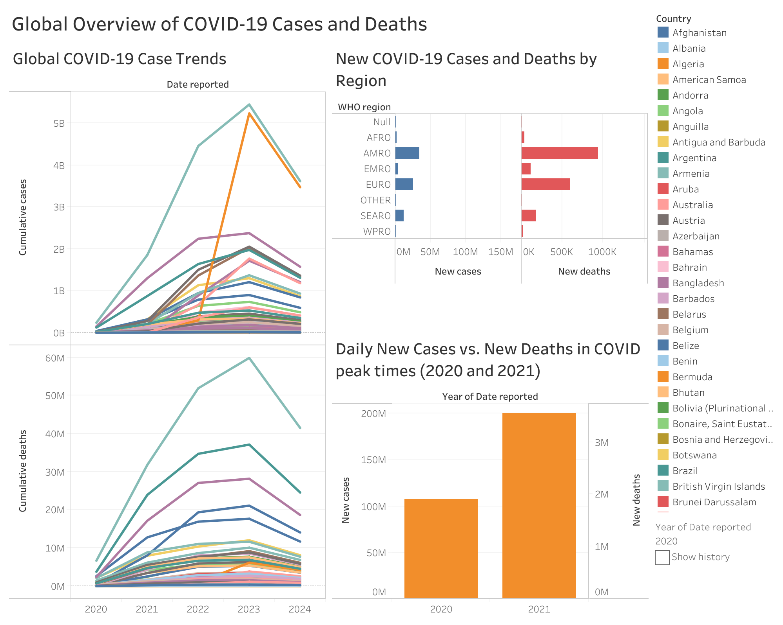
Key Insights:
Global Case and Death Patterns: The combined charts show rapid case growth, especially in 2022, with EURO and AMRO regions being hit hardest. Despite similar case surges, EURO saw higher death rates, pointing to differences in healthcare responses.
Regional Disparities: The mix of visuals highlights how regions like EURO had worse death outcomes despite comparable cases with AMRO, revealing disparities in healthcare capacity and pandemic management.
Case-Death Lag: The combination of case and death trends shows a clear lag, emphasizing that rising cases lead to delayed spikes in deaths, underscoring the need for early interventions.
This integrated dashboard offers a global and regional comparison, showcasing the uneven impact of COVID-19 and the importance of timely responses.

Slide 11
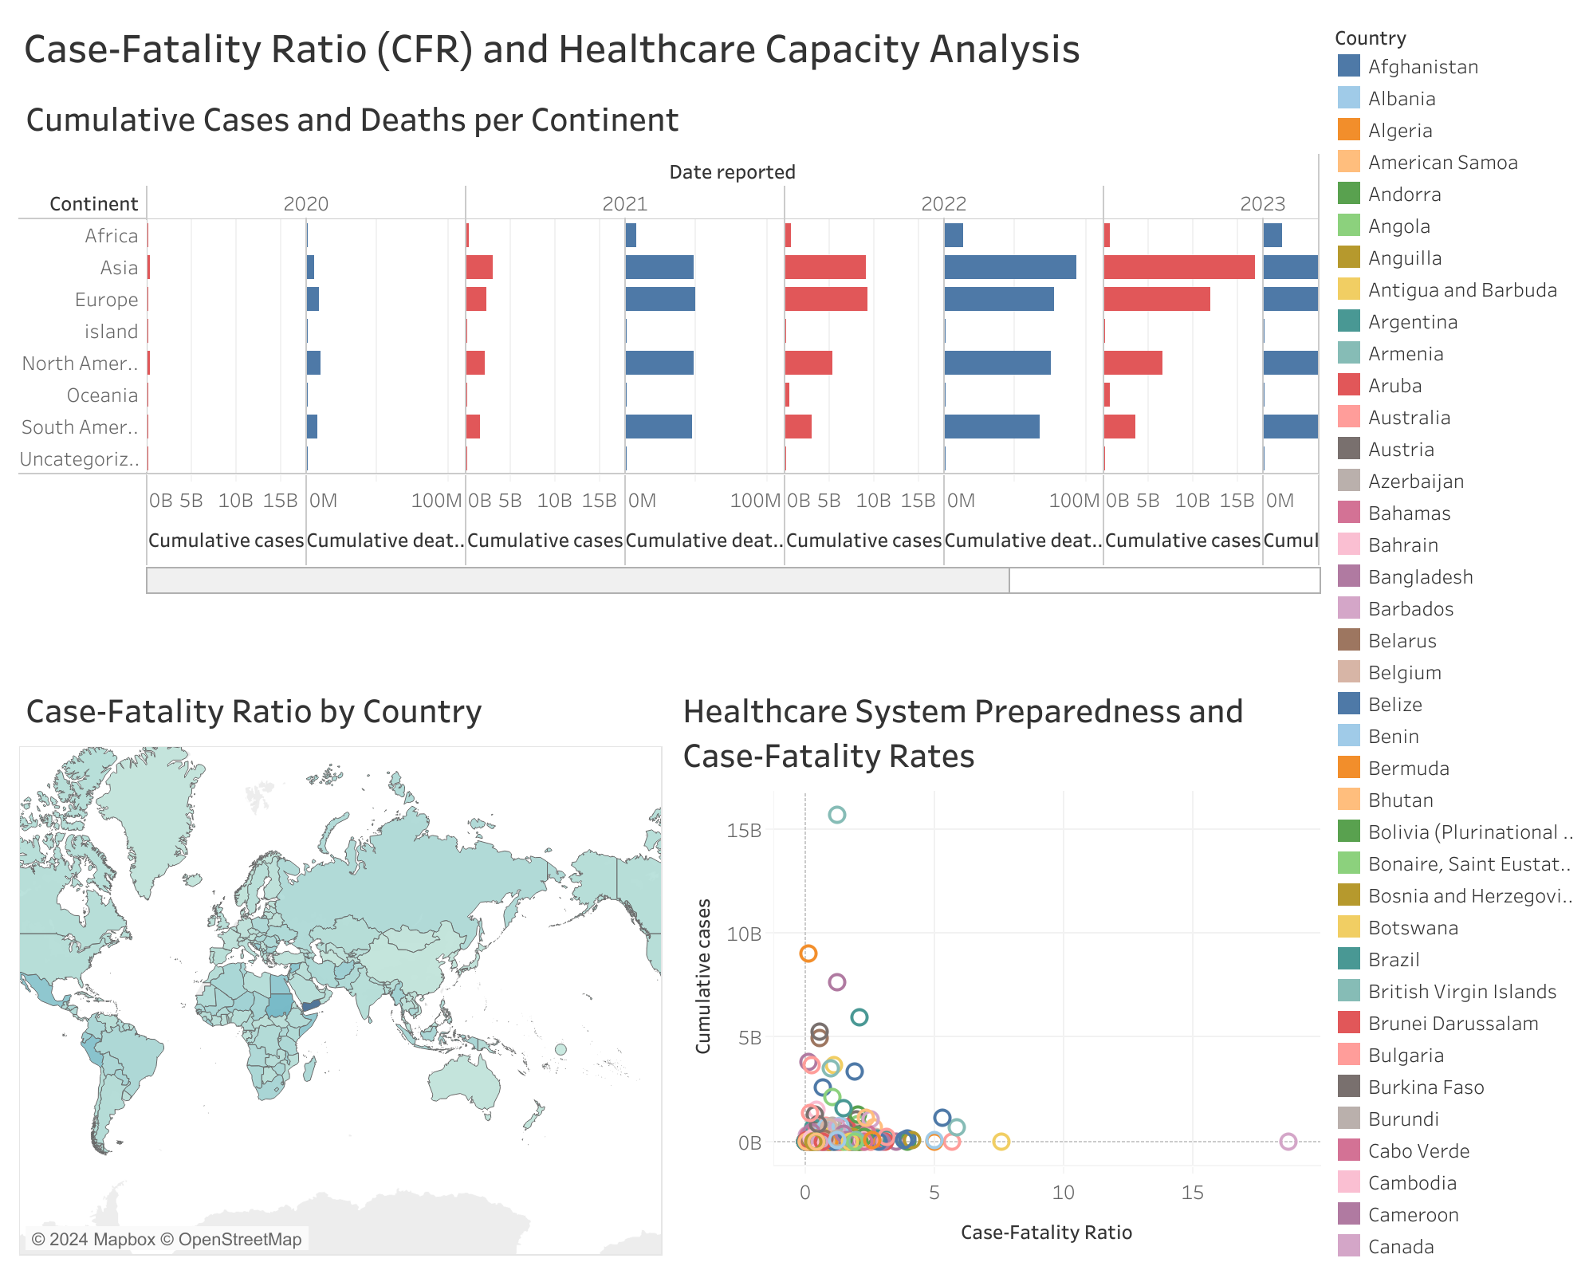
Case-Fatality Ratio and Healthcare Analysis: The combined charts provide a clear comparison of cumulative cases, deaths, and case-fatality ratios across continents. Europe and North America show consistently high case-fatality rates, especially in 2020, highlighting their early vulnerability to COVID-19.
Global CFR Distribution: The map visualization offers a geographical perspective, revealing countries with higher fatality rates, such as Yemen and Afghanistan, pointing to weaker healthcare systems.
Preparedness vs. Fatality: The scatter plot shows that countries with high cases but lower CFR, like Germany, indicate better healthcare preparedness. Meanwhile, countries with fewer cases but higher CFR suggest healthcare systems struggling with severe outcomes.
This dashboard highlights global healthcare disparities and underscores how effective healthcare responses are tied to lower fatality rates.

Slide 12
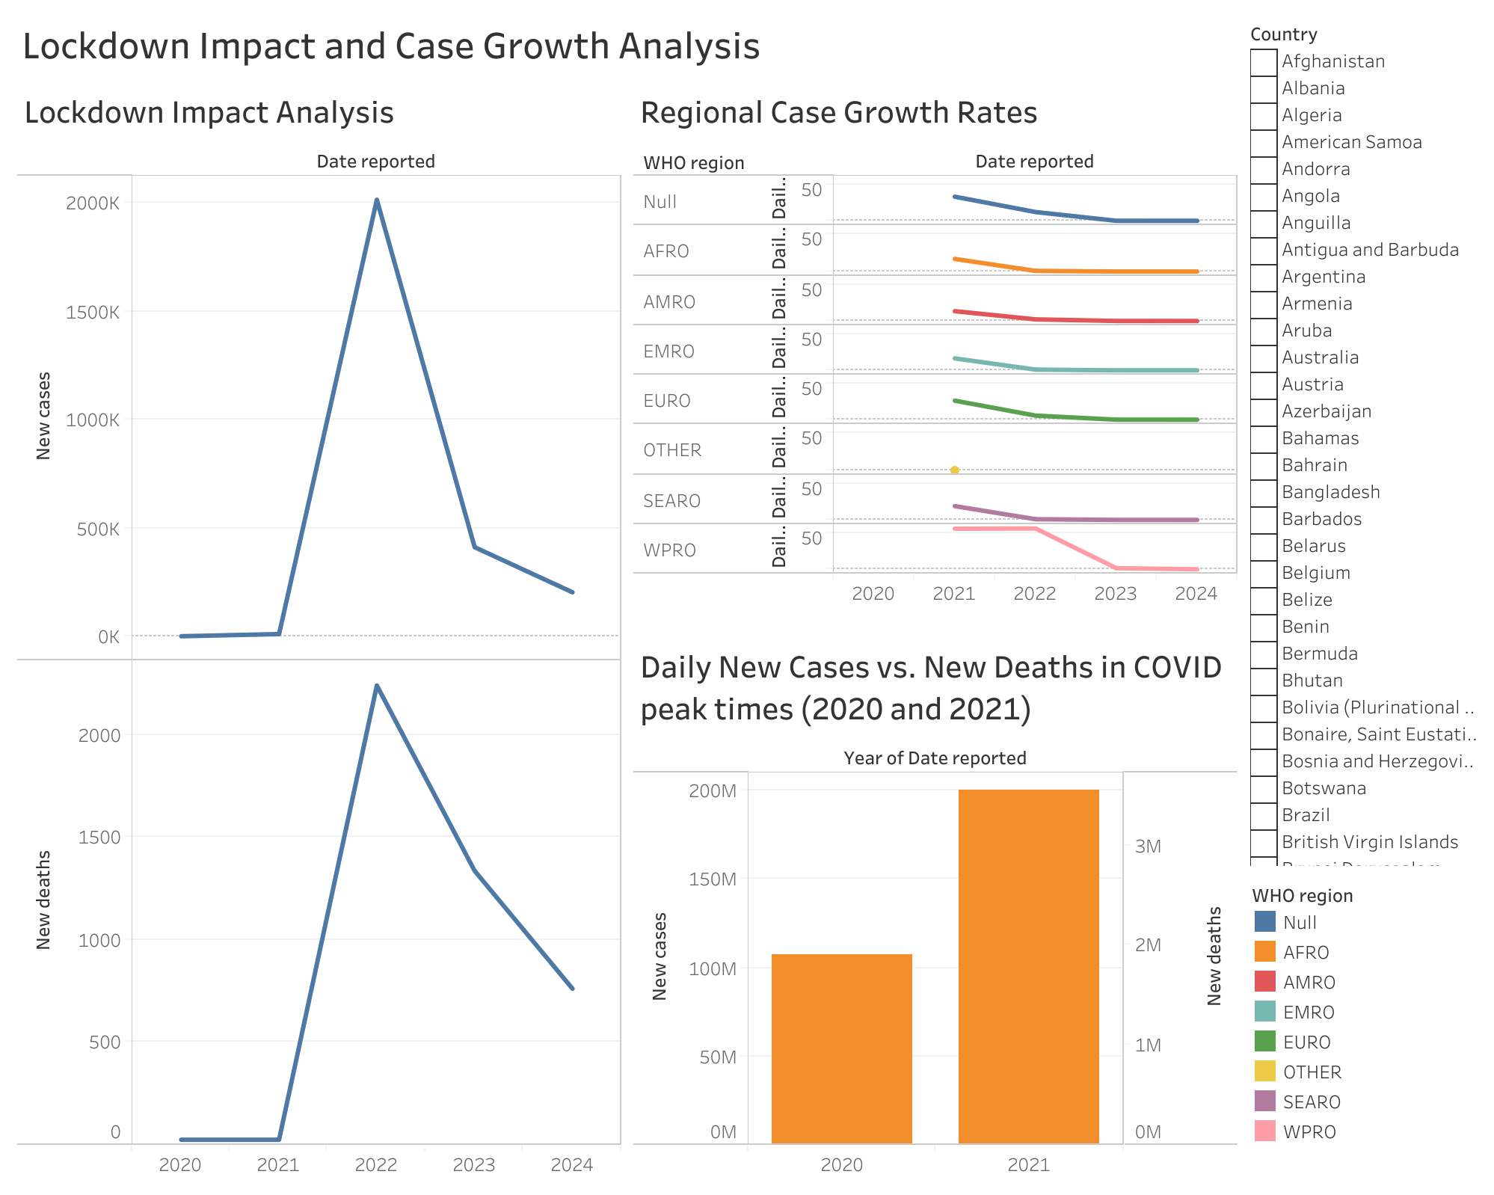
Lockdown Impact: The line chart reveals a steep rise in new cases during the 2022 peak, followed by a sharp decline. This shows the significant effect of lockdowns and public health measures in reducing case numbers after the peak.
Regional Growth Rates: The chart shows a steady decline in daily growth rates across all WHO regions post-2022, indicating the global success of containment efforts. AMRO and EURO had initially higher growth rates, but they also saw significant drops, reflecting the long-term impact of interventions.
New Cases vs. Deaths: The bar chart comparing 2020 and 2021 shows that while new cases surged in 2021, there was a corresponding sharp rise in deaths, indicating the deadly nature of the virus during this period.
This dashboard emphasizes the effectiveness of lockdowns in 2022, the regional variations in growth rates, and the significant global reduction in cases and deaths over time.

